Slide 1

Audio Captioning and Retrieval with improved Cross-Modal Objectives
presented by
Andrew Koh Jin Jie
Supervisor
Assoc. Prof. Chng Eng Siong
6 December 2023
Notes:
I am
supervised by
My work is titled

Slide 2
Publications
[C1] Andrew Koh, Xue Fuzhao and Eng Siong Chng, ”Automated Audio Captioning Using Transfer Learning and Reconstruction Latent Space Similarity Regularization,” ICASSP 2022 - 2022 IEEE International Conference on Acoustics, Speech and Signal Processing (ICASSP), 2022, pp. 7722-7726
[C2] Andrew Koh, Soham Tiwari and Eng Siong Chng, ”Automated Audio Captioning with Epochal Difficult Captions for curriculum learning,” 2022 Asia-Pacific Signal and Information Processing Association Annual Summit and Conference (APSIPA ASC), 2022, pp. 1058-1063
[C3] Andrew Koh and Eng Siong Chng, ”Language-based audio retrieval with Converging Tied Layers and Contrastive Loss,” 2022 Asia-Pacific Signal and Information Processing Association Annual Summit and Conference (APSIPA ASC), 2022, pp. 1644-1648
Boon Peng Yap, Andrew Koh, and Eng Siong Chng. 2020. Adapting BERT for Word Sense Disambiguation with Gloss Selection Objective and Example Sentences. In Findings of the Association for Computational Linguistics: EMNLP 2020, pages 41–46
Tanmay Khandelwal, Rohan Kumar Das, Andrew Koh and Eng Siong Chng, “Leveraging Audio-Tagging Assisted Sound Event Detection using Weakified Strong Labels and Frequency Dynamic Convolutions”, in Proc. IEEE Statistical Signal Processing Workshop 2023, Hanoi, Vietnam, July 2023.
Notes:
Outline of my presentation
Research focuses on 2 main topics

Slide 3
Outline
1. Automated Audio Captioning (AAC)
What is AAC?
How are AAC models trained?
Which datasets, encoders, and decoders are used for AAC?
How are AAC models evaluated?
C1: Reconstruction Latent Space Similarity Regularization for AAC
C2: Epochal Difficult Captions for AAC
2. Language Based Audio Retrieval (LBAR)
What is LBAR?
How are LBAR models trained?
What datasets are used for LBAR?
How are LBAR models evaluated?
C3: Converging Tied Layers for LBAR
Conclusions & Future Work
Notes:
Outline of my presentation
Research focuses on 2 main topics

Slide 4
Outline
1. Automated Audio Captioning (AAC)
What is AAC?
How are AAC models trained?
Which datasets, encoders, and decoders are used for AAC?
How are AAC models evaluated?
C1: Reconstruction Latent Space Similarity Regularization for AAC
C2: Epochal Difficult Captions for AAC
2. Language Based Audio Retrieval (LBAR)
What is LBAR?
How are LBAR models trained?
What datasets are used for LBAR?
How are LBAR models evaluated?
C3: Converging Tied Layers for LBAR
Conclusions & Future Work
Notes:
i will now give an introduction to automated audio captioning

Slide 5
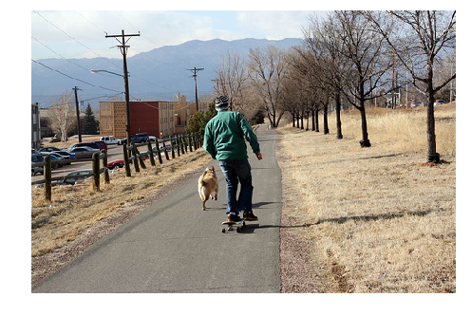
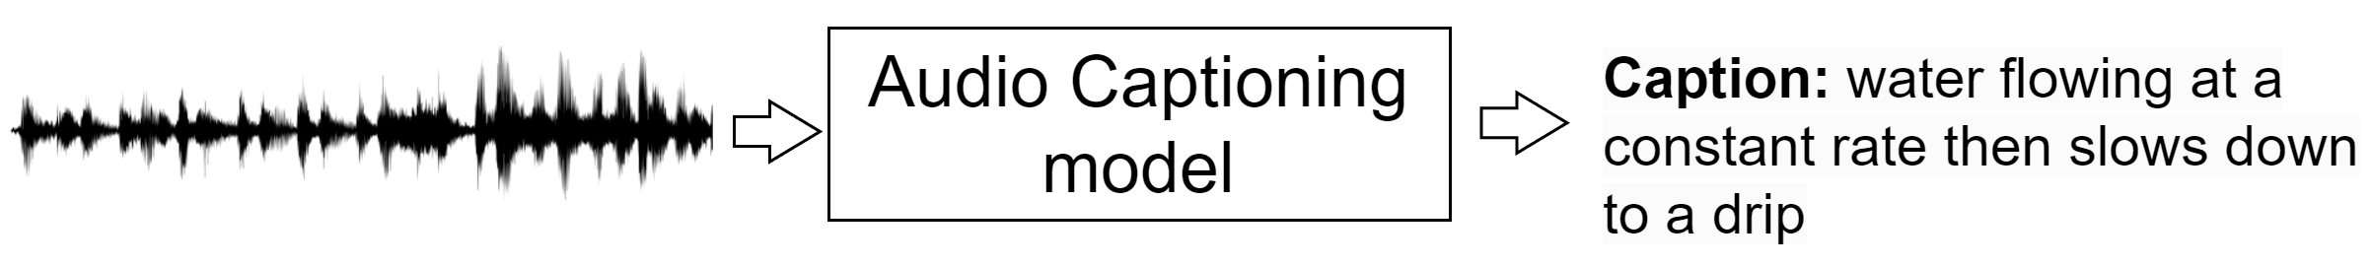
Primer: AAC
Image Captioning ^{[38]}
Describe an image using natural language
Image Captioning model
Caption: A man on a skateboard with a dog outside ^{[a]}
Automated Audio Captioning ^{[11]}
Describe audio events using natural language
[a] https://cocodataset.org
[11] Konstantinos Drossos, Sharath Adavanne, and Tuomas Virtanen. Automated audio captioning with recurrent neural networks. In 2017 IEEE Workshop on Applications of Signal Processing to Audio and Acoustics (WASPAA), pages 374–378, 2017. doi:10.1109/WASPAA.2017.8170058.​
[38] Matteo Stefanini, Marcella Cornia, Lorenzo Baraldi, Silvia Cascianelli, Giuseppe Fiameni, and Rita Cucchiara. From Show to Tell: A Survey on Deep Learning-Based Image Captioning. IEEE Transactions on Pattern Analysis and Machine Intelligence, 45:539–559, 2021.
Notes:
Image captioning, a task in computer vision, is the task to
(describe the example: input, output)
On the other hand, AAC is to,
Describe example

Slide 6
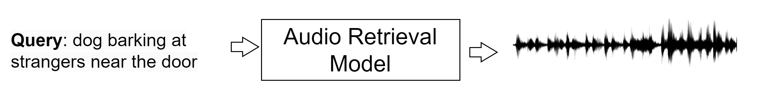
Primer: AAC and LBAR
Automated Audio Captioning ^{[11]}
Describe audio events using natural language
Language based Audio Retrieval ^{[3]}
Retrieve the most relevant audio clip
Retrieve the most relevant audio clip
(done by ranking a collection of audio clips)
[11] Konstantinos Drossos, Sharath Adavanne, and Tuomas Virtanen. Automated audio captioning with recurrent neural networks. In 2017 IEEE Workshop on Applications of Signal Processing to Audio and Acoustics (WASPAA), pages 374–378, 2017. doi:10.1109/WASPAA.2017.8170058.​
[3] Xuenan Xu, Heinrich Dinkel, Mengyue Wu, and Kai Yu. Text-to-Audio Grounding: Building Correspondence Between Captions and Sound Events. In ICASSP 2021 - 2021 IEEE International Conference on Acoustics, Speech and Signal Processing (ICASSP), pages 606–610, 2021. doi: 10.1109/ ICASSP39728.2021.9414834.
Notes:
Now that we have talked about AAC,
While aac takes in audio input and produces an output caption, LBAR is the takes in query caption to retrieve the most relevant audio clip

Slide 7
Primer: AAC and LBAR
Automated Audio Captioning
Language based Audio Retrieval
Detection and Classification of Acoustic Scenes and Events (DCASE)
Yearly workshop and competition
AAC: 2020 ^{[a]}
LBAR: 2022 ^{[b]}
[a] https://dcase.community/challenge2020/
[b] https://dcase.community/challenge2022/
Notes:
Both AAC and LBAR was proposed as a challenge task in

Slide 8

Primer: AAC and LBAR
Automated Audio Captioning
Language based Audio Retrieval
2. Clotho Dataset ^{[83]}
Audio: 4981 clips of 15 to 30s duration
Captions: 8 to 20 words long
While birds chirp in the background, a car drives down the street and shifts gears
As birds sing in the background, a car drives by, humming loudly.
Cars are racing down the track and birds are tweeting.
Cars drive by and a loud car hums as birds sing in the background.
A motorcycle speeds up and gets closer then fades into the distance as birds chirp.
Taken from validation set
[83] Konstantinos Drossos, Samuel Lipping, and Tuomas Virtanen. Clotho: an Audio Captioning Dataset. In ICASSP 2020 - 2020 IEEE International Conference on Acoustics, Speech and Signal Processing (ICASSP), pages 736– 740, 2020. doi: 10.1109/ICASSP40776.2020.9052990
Notes:
In DCASE, the clotho dataset is used to train our models
Describe points
While there are other datasets, the clotho dataset is commonly used of reasons I will go into later in the literature review.
I will now play a sample clip

Slide 9
Primer: AAC and LBAR
Automated Audio Captioning
Language based Audio Retrieval
2. Clotho Dataset ^{[83]}
Audio: 4981 clips of 15 to 30s duration
Captions: 8 to 20 words long
Freesound.org
Filename | Caption
20090412.fountain.wav | A water fountain is gurgling very close by
Garage Nat Sound_01.wav | Various birds are chirping at a short distance over a hum in the background
Meow for food.wav | A cat starts meowing and then another cat joins in then a man starts speaking.
TheGym.wav | Many people talking in a enclosed space, bar or restaurant while music plays
Ocean waves Smygehuk 2.wav | Wave after wave is crashing down on a beach.
[83] Konstantinos Drossos, Samuel Lipping, and Tuomas Virtanen. Clotho: an Audio Captioning Dataset. In ICASSP 2020 - 2020 IEEE International Conference on Acoustics, Speech and Signal Processing (ICASSP), pages 736– 740, 2020. doi: 10.1109/ICASSP40776.2020.9052990
Notes:
The clotho dataset is sourced from freesound.org, and consists of many sound events which are uploaded to users. There is no limitation to the genre
For example, the sounds could be of..

Slide 10
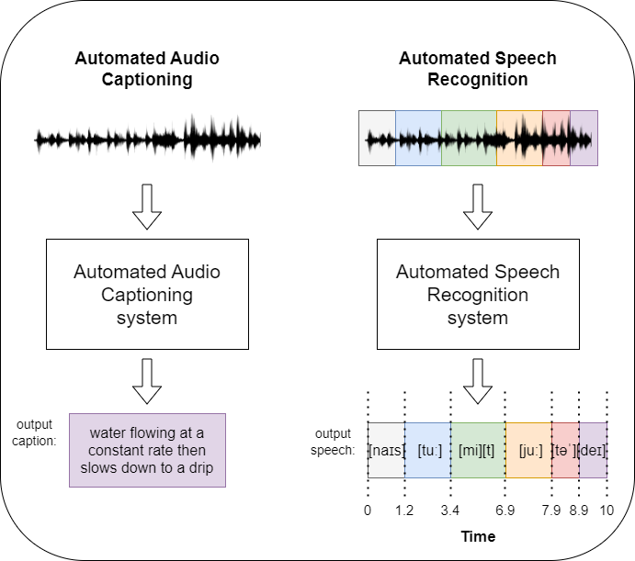
1a) How does AAC differ from Automated Speech Recognition
Requires an understanding of a broad range of audio events
Requires natural language comprehension/generation
Notes:
AAC models need to be able to understand audio events in the audio clip and generate an output caption in natural language
On the other hand, ASR is more focused on transcribing speech in the audio clip
In AAC, not concerned with input/output alignment, but more concerned with a proper description of the temporal timeline in the audio clip

Slide 11
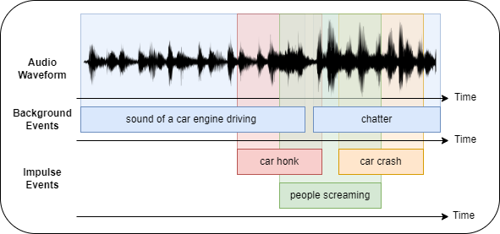
1a) What information should the AAC models have?
Detect and distinguish overlapping impulse and background events
detected events -> textual description ^{[11]}
[11] Konstantinos Drossos, Sharath Adavanne, and Tuomas Virtanen. Automated audio captioning with recurrent neural networks. In 2017 IEEE Workshop on Applications of Signal Processing to Audio and Acoustics (WASPAA), pages 374–378, 2017. doi:10.1109/WASPAA.2017.8170058.
Notes:
AAC models should be able to detect and differentiate overlapping impulse and background event
(describe example)
These detected events should be turned into a textual description
For example, one possible caption for this example could be 'a car honking on a busy road followed by a loud crash'

Slide 12
1a) How does AAC differ from Image Captioning?
 | Audio Captioning | Image Captioning ^{[38]}
Input | Auditory (Waveforms, spectrograms) | Visual input (Pixel data, visual features)
Nature | Temporal | Inherently static
Content | Music, Environmental sounds, Speech | Objects, Scenes
Methods | CNNs ^{[7]}, Transformers ^{[36, 39-42]} , Attention mechanisms
[38] Matteo Stefanini, Marcella Cornia, Lorenzo Baraldi, Silvia Cascianelli, Giuseppe Fiameni, and Rita Cucchiara. From Show to Tell: A Survey on Deep Learning-Based Image Captioning. IEEE Transactions on Pattern Analysis and Machine Intelligence, 45:539–559, 2021.
[7] Kaiming He, X. Zhang, Shaoqing Ren, and Jian Sun. Deep Residual Learning for Image Recognition. 2016 IEEE Conference on Computer Vision and Pattern Recognition (CVPR), pages 770–778, 2015.
[36] Quanzeng You, Hailin Jin, Zhaowen Wang, Chen Fang, and Jiebo Luo. Image Captioning with Semantic Attention. 2016 IEEE Confeence on Computer Vision and Pattern Recognition (CVPR), pages 4651–4659, 2016.
[39] Zhengcong Fei. Fast Image Caption Generation with Position Alignment. ArXiv, abs/1912.06365, 2019 [40] Longteng Guo, Jing Liu, Xinxin Zhu, Xingjian He, Jie Jiang, and Hanqing Lu. Non-Autoregressive Image Captioning with CounterfactualsCritical Multi-Agent Learning. In Christian Bessiere, editor, Proceedings of the Twenty-Ninth International Joint Conference on Artificial Intelligence, IJCAI-20, pages 767–773. International Joint Conferences on Artificial Intelligence Organization, 7 2020. doi: 10.24963/ijcai.2020/107.
[41] Zhengcong Fei. Iterative Back Modification for Faster Image Captioning. In Proceedings of the 28th ACM International Conference on Multimedia, MM’20, page 3182–3190, New York, NY, USA, 2020. Association for Computing Machinery. ISBN 9781450379885. doi: 10.1145/3394171.3413901
[42] ] Longteng Guo, Jing Liu, Xinxin Zhu, and Hanqing Lu. Fast Sequence Generation with Multi-Agent Reinforcement Learning. ArXiv, abs/2101.09698, 2021
Notes:
Talk about table

Slide 13
1a) How does AAC differ from Video Captioning?
 | Audio Captioning | Image Captioning | Video Captioning ^{[43]}
Input | Auditory (Waveforms, spectrograms) | Visual (Pixel data, visual features) | Both Auditory and Visual
Nature | Temporal | Inherently static | Temporal
Content | Music, Environmental sounds, Speech | Objects, Scenes | Motion, Action, Conversation (much broader content)
Methods | CNNs, Transformers, Attention mechanisms |  | + feature fusion tactics
[43] Saiful Islam, Aurpan Dash, Ashek Seum, Amir Raj, Tonmoy Hossain, and Faisal Shah. Exploring Video Captioning Techniques: A Comprehensive Survey on Deep Learning Methods. SN Computer Science, 2, 04 2021. doi: 10.1007/s42979-021-00487-x
Notes:
Talk about the table,
Mention video captioning is harder
Methods everything + feature fusion tactics

Slide 14
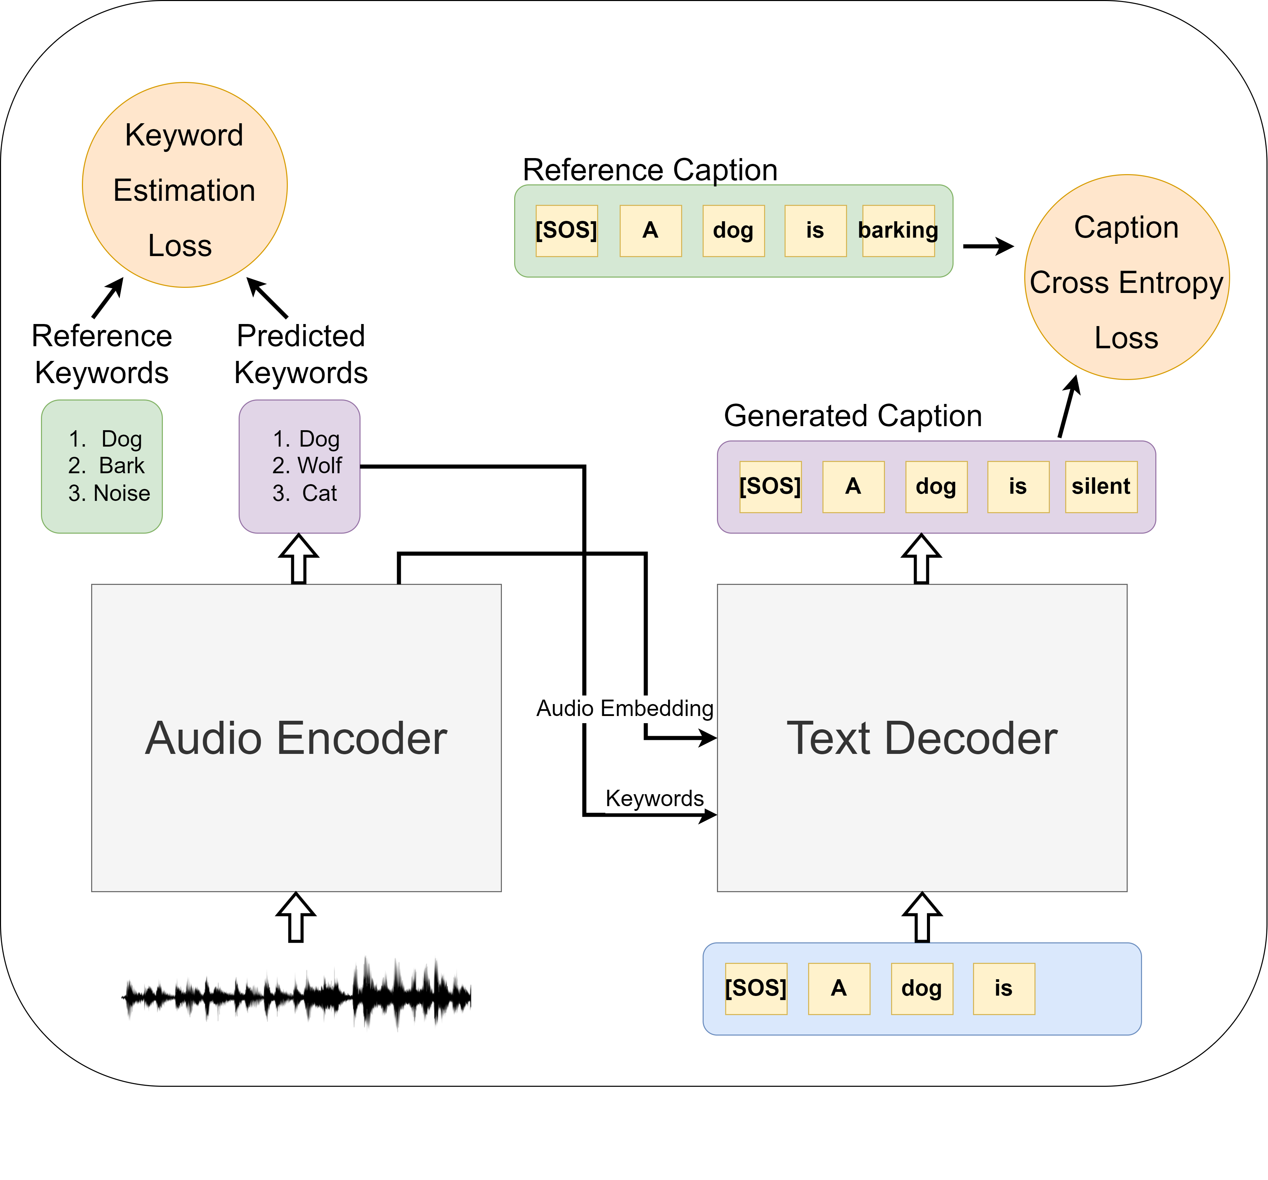
1b) How are AAC models trained?
Encoder-Decoder architecture
Cross Entropy Loss for caption generation
Loss from supplementary objectives ^{[66, 74, 75]}
keyword estimation
sound event classification
[66] K. Chen, Y. Wu, Z. Wang, X. Zhang, F. Nian, S. Li, and X. Shao. Audio Captioning Based on Transformer and Pre-Trained CNN. In Proceedings of the Detection and Classification of Acoustic Scenes and Events 2020 Workshop (DCASE2020), pages 21–25, Tokyo, Japan, Nov. 2020.
[74] Heinrich Dinkel and Kai Yu. Duration Robust Weakly Supervised Sound Event Detection. ICASSP 2020 - 2020 IEEE International Conference on Acoustics, Speech and Signal Processing (ICASSP), May 2020. doi: 10.1109/icassp40776.2020.9053459. URL http://dx.doi.org/10.1109/ ICASSP40776.2020.9053459.
[75] Xinhao Mei, Xubo Liu, Qiushi Huang, Mark D. Plumbley, and Wenwu Wang. Audio Captioning Transformer. In Workshop on Detection and Classification of Acoustic Scenes and Events, 2021. URL https://api.semanticscholar. org/CorpusID:236154948.
Notes:
Most AAC models follow an encoder decoder architecture
(reference the example using mouse)
They are trained by minimizing the cross entropy loss which is calculated using the reference caption and the generated caption
Some researchers use supplementary objectives such as
In this example, the audio encoder is trained on keyword estimation

Slide 15
1c) Which datasets are used for audio captioning?
Dataset | Number of Samples | Audio length (s) | Number of Arxiv References | Content obtained from
Clotho Dataset [83] | 4981 | 15-30 | 26 | freesound.org (open ended)
Audiocaps [82] | 46000 | 10 | 17 | Audioset [19] (sound events)
Hospital Scene [72] | 3709 | 10 | 1 | Hospital video clips in Mandarin
Car Scene [72] | 3602 | 10 | 1 | Car video clips in Mandarin
[83] Konstantinos Drossos, Samuel Lipping, and Tuomas Virtanen. Clotho: an Audio Captioning Dataset. In ICASSP 2020 - 2020 IEEE International Conference on Acoustics, Speech and Signal Processing (ICASSP), pages 736– 740, 2020. doi: 10.1109/ICASSP40776.2020.9052990
[82] Chris Dongjoo Kim, Byeongchang Kim, Hyunmin Lee, and Gunhee Kim. AudioCaps: Generating Captions for Audios in The Wild. In Proceedings of the 2019 Conference of the North American Chapter of the Association for Computational Linguistics: Human Language Technologies, Volume 1 (Long and Short Papers), pages 119–132, Minneapolis, Minnesota, June 2019. Association for Computational Linguistics. doi: 10.18653/v1/N19-1011.
[72] Xuenan Xu, Heinrich Dinkel, Mengyue Wu, and Kai Yu. Audio Caption in a Car Setting with a Sentence-Level Loss. In 2021 12th International Symposium on Chinese Spoken Language Processing (ISCSLP), pages 1–5, 2021. doi: 10.1109/ISCSLP49672.2021.9362117
Notes:
Describe the table

Slide 16
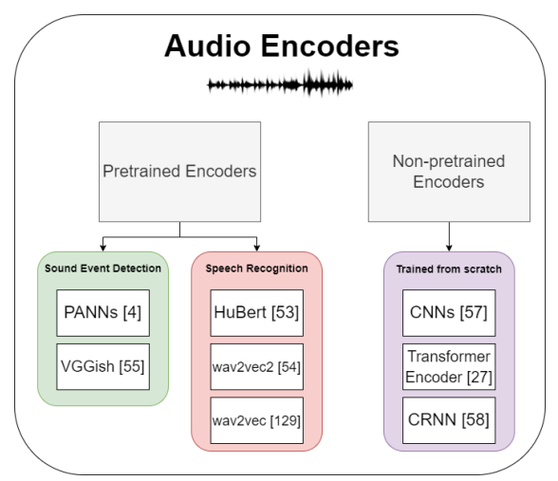
1c) What audio encoders are used for AAC?
[4] Qiuqiang Kong, Yin Cao, Turab Iqbal, Yuxuan Wang, Wenwu Wang, and Mark D. Plumbley. PANNs: Large-Scale Pretrained Audio Neural Networks for Audio Pattern Recognition. IEEE/ACM Transactions on Audio, Speech, and Language Processing, 28:2880–2894, 2020. doi: 10.1109/TASLP.2020. 3030497
[55] Shawn Hershey, Sourish Chaudhuri, Daniel P. W. Ellis, Jort F. Gemmeke, Aren Jansen, R. Channing Moore, Manoj Plakal, Devin Platt, Rif A. Saurous, Bryan Seybold, Malcolm Slaney, Ron J. Weiss, and Kevin Wilson. CNN architectures for large-scale audio classification. In 2017 IEEE International Conference on Acoustics, Speech and Signal Processing (ICASSP), pages 131– 135, 2017. doi: 10.1109/ICASSP.2017.7952132.
[53] Wei-Ning Hsu, Benjamin Bolte, Yao-Hung Hubert Tsai, Kushal Lakhotia, Ruslan Salakhutdinov, and Abdel rahman Mohamed. Hubert: Self supervised speech representation learning by masked prediction of hidden units. IEEE/ACM Transactions on Audio, Speech, and Language Processing, 29:3451–3460, 2021.
[54] Alexei Baevski, Yuhao Zhou, Abdelrahman Mohamed, and Michael Auli. wav2vec 2.0: A Framework for Self-Supervised Learning of Speech Representations. In H. Larochelle, M. Ranzato, R. Hadsell, M.F. Balcan, and H. Lin, editors, Advances in Neural Information Processing Systems, volume 33, pages 12449–12460. Curran Associates, Inc., 2020.
[129] Steffen Schneider, Alexei Baevski, Ronan Collobert, and Michael Auli. wav2vec: Unsupervised Pre-training for Speech Recognition. In Interspeech, 2019.
[57] Alex Krizhevsky, Ilya Sutskever, and Geoffrey E Hinton. ImageNet Classification with Deep Convolutional Neural Networks. In F. Pereira C.J. Burges, L. Bottou, and K.Q. Weinberger, editors, Advances in Neural Information Processing Systems, volume 25. Curran Associates, Inc., 2012
[27] Ashish Vaswani, Noam M. Shazeer, Niki Parmar, Jakob Uszkoreit, Llion Jones, Aidan N. Gomez, Lukasz Kaiser, and Illia Polosukhin. Attention is All you Need. In NIPS, 2017.
[58] Baoguang Shi, Xiang Bai, and Cong Yao. An End-to-End Trainable Neural Network for Image-Based Sequence Recognition and Its Application to Scene Text Recognition. IEEE Transactions on Pattern Analysis and Machine Intelligence, 39:2298–2304, 2015
Notes:
There are many audio encoders
Can be classified into pretrained encoders and non-pretrained encoders
Pretrained encoders are the most popular, and in AAC, pretrained encoders such as PANNs are popular
In my research, we use a combination of PANNs and Transformer encoders.

Slide 17
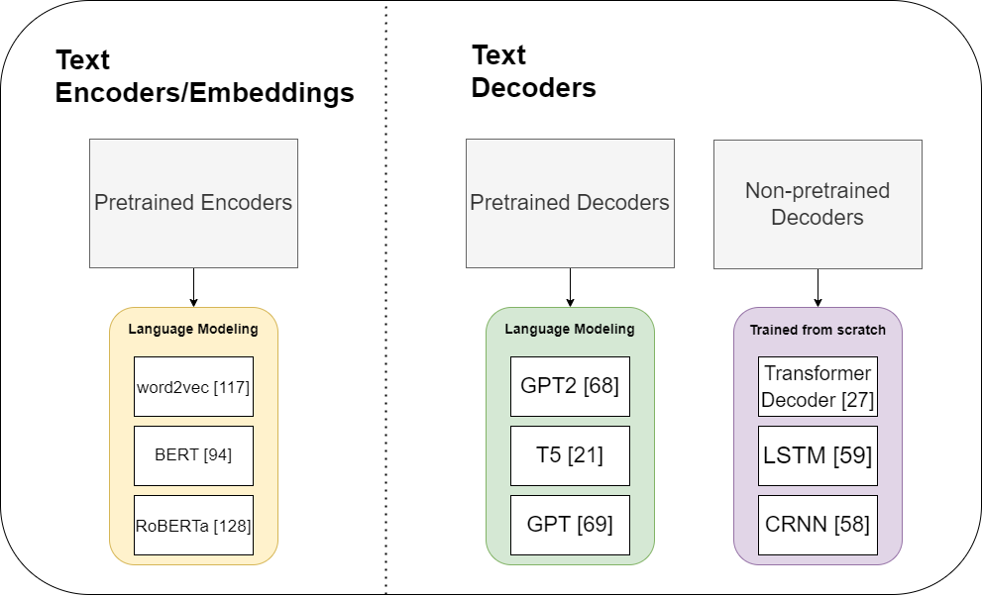
1c) What text decoders are used for AAC?
[117] Tomas Mikolov, Kai Chen, Gregory S. Corrado, and Jeffrey Dean. Efficient Estimation of Word Representations in Vector Space. In International Conference on Learning Representations, 2013
[94] Jacob Devlin, Ming-Wei Chang, Kenton Lee, and Kristina Toutanova. BERT: Pre-training of Deep Bidirectional Transformers for Language Understanding. In Proceedings of the 2019 Conference of the North American Chapter of the Association for Computational Linguistics: Human Language Technologies, Volume 1 (Long and Short Papers), pages 4171–4186, Minneapolis, Minnesota, June 2019. Association for Computational Linguistics. doi: 10.18653/v1/N19-1423
[128] Yinhan Liu, Myle Ott, Naman Goyal, Jingfei Du, Mandar Joshi, Danqi Chen, Omer Levy, Mike Lewis, Luke Zettlemoyer, and Veselin Stoyanov. RoBERTa: A Robustly Optimized BERT Pretraining Approach. ArXiv, abs/1907.11692, 2019.
[68] Alec Radford, Jeff Wu, Rewon Child, David Luan, Dario Amodei, and Ilya Sutskever. Language Models are Unsupervised Multitask Learners. 2019
[21] Colin Raffel, Noam Shazeer, Adam Roberts, Katherine Lee, Sharan Narang, Michael Matena, Yanqi Zhou, Wei Li, and Peter J. Liu. Exploring the Limits of Transfer Learning with a Unified Text-to-Text Transformer. J. Mach. Learn. Res., 21(1), jun 2022. ISSN 1532-4435
[69] Alec Radford and Karthik Narasimhan. Improving Language Understanding by Generative Pre-Training
[27] Ashish Vaswani, Noam M. Shazeer, Niki Parmar, Jakob Uszkoreit, Llion Jones, Aidan N. Gomez, Lukasz Kaiser, and Illia Polosukhin. Attention is All you Need. In NIPS, 2017.
[59] Jeffrey L. Elman. Finding structure in time. Cognitive Science, 14(2):179– 211, 1990. ISSN 0364-0213. doi: https://doi.org/10.1016/0364-0213(90) 90002-E
[58] Baoguang Shi, Xiang Bai, and Cong Yao. An End-to-End Trainable Neural Network for Image-Based Sequence Recognition and Its Application to Scene Text Recognition. IEEE Transactions on Pattern Analysis and Machine Intelligence, 39:2298–2304, 2015
Notes:
Since AAC is a generative task, text decoders are required in the model. Common pretrained decoders are GPT2, and nonpretrained decoders like the standard transformer decoder
Some researchers also try to supplement the text decoder with text embeddings from pretrained encoders.

Slide 18
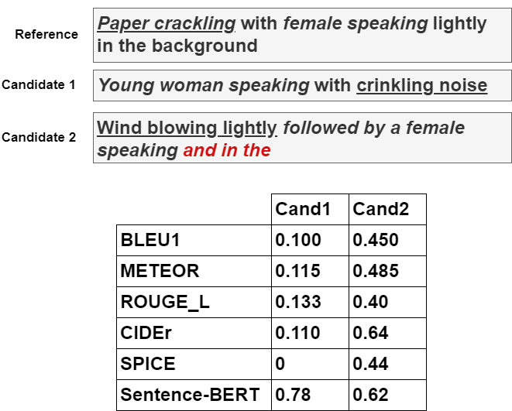
1d) How is evaluation of AAC models done?
Traditional Metrics
BLEU [85], ROUGE_L [86], METEOR [87], CIDEr [88], SPICE [89], SPIDEr [90]
Values: 0-1, the higher the better.
Alternative Metric
FENSE [93] uses Sentence-Bert
[85] Kishore Papineni, Salim Roukos, Todd Ward, and Wei-Jing Zhu. BLEU: A Method for Automatic Evaluation of Machine Translation. In Proceedings of the 40th Annual Meeting on Association for Computational Linguistics, ACL ’02, page 311–318, USA, 2002. Association for Computational Linguistics. doi: 10.3115/1073083.1073135
[86] Chin-Yew Lin. ROUGE: A package for automatic evaluation of summaries. In Text Summarization Branches Out, pages 74–81, Barcelona, Spain, July 2004. Association for Computational Linguistics [87] Michael Denkowski and Alon Lavie. Meteor Universal: Language Specific Translation Evaluation for Any Target Language [88] Ramakrishna Vedantam, C. Lawrence Zitnick, and Devi Parikh. CIDEr: Consensus-based image description evaluation. In 2015 IEEE Conference on Computer Vision and Pattern Recognition (CVPR), pages 4566–4575, 2015. doi: 10.1109/CVPR.2015.7299087. [89] Peter Anderson, Basura Fernando, Mark Johnson, and Stephen Gould. SPICE: Semantic Propositional Image Caption Evaluation. In Bastian Leibe, Jiri Matas, Nicu Sebe, and Max Welling, editors, Computer Vision – ECCV 2016, pages 382–398, Cham, 2016. Springer International Publishing.
[90] Siqi Liu, Zhenhai Zhu, Ning Ye, Sergio Guadarrama, and Kevin Murphy. Improved Image Captioning via Policy Gradient optimization of SPIDEr. 2017 IEEE International Conference on Computer Vision (ICCV), Oct 2017. doi: 10.1109/iccv.2017.100. URL http://dx.doi.org/10.1109/ICCV.2017.100. [93] Zelin Zhou, Zhiling Zhang, Xuenan Xu, Zeyu Xie, Mengyue Wu, and Kenny Q. Zhu. Can Audio Captions Be Evaluated With Image Caption Metrics? ICASSP 2022 - 2022 IEEE International Conference on Acoustics, Speech and Signal Processing (ICASSP), pages 981–985, 2021
Notes:
Metrics borrowed from machine translation
Shortcomings
Rely on overlap
Does not check for proper sentence structure
Alternative metrics are not popular
Note that while there are many metrics, the main metric to researchers focus on is SPIDEr, which is a weighted combination of CIDEr and SPICE.

Slide 19
Outline
1. Automated Audio Captioning (AAC)
What is AAC?
How are AAC models trained?
Which datasets, encoders, and decoders are used for AAC?
How are AAC models evaluated?
C1: Reconstruction Latent Space Similarity Regularization for AAC
C2: Epochal Difficult Captions for AAC
2. Language Based Audio Retrieval (LBAR)
What is LBAR?
How are LBAR models trained?
What datasets are used for LBAR?
How are LBAR models evaluated?
C3: Converging Tied Layers for LBAR
Conclusions & Future Work
Notes:
Now I will talk about my first contribution to AAC.

Slide 20
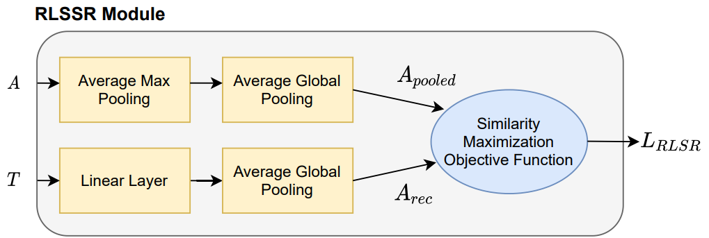
C1: Reconstruction Latent Space Similarity Regularization (RLSSR) for Automated Audio Captioning
C1.1 Motivation
C1.2 Model architecture
C1.3 Experiments and results
Published as:
A. Koh, X. Fuzhao and C. E. Siong, ”Automated Audio Captioning Using Transfer Learning and Reconstruction Latent Space Similarity Regularization,” ICASSP 2022 - 2022 IEEE International Conference on Acoustics, Speech and Signal Processing (ICASSP), 2022, pp. 7722-7726, doi: 10.1109/ICASSP43922.2022.9747676.
Notes:
In this contribution, I introduce RLSSR, a self supervised objective that helps to guide the training of the model.

Slide 21
C1.1 Motivation
Weak Gradient Flow from decoder to encoder
Self Supervised Objectives can mitigate this
Inspired by Computer vision methods
Architecture Design – Added Transformer Encoder
Most prior work use only a CNN audio encoder
self-attention mechanism – good at processing sequential contextual data due to their self-attention mechanism.
focus on impulse sound events such as ’explosion’ or ’gunshot’
Published as:
A. Koh, X. Fuzhao and C. E. Siong, ”Automated Audio Captioning Using Transfer Learning and Reconstruction Latent Space Similarity Regularization,” ICASSP 2022 - 2022 IEEE International Conference on Acoustics, Speech and Signal Processing (ICASSP), 2022, pp. 7722-7726, doi: 10.1109/ICASSP43922.2022.9747676.
Notes:
My motivation behind this work was to improve gradient flow from the decoder to the encoder.
This approach is inspired by reconstruction tactics from computer vision
As Audio captioning dealt with audio input and text outputs which are of different modalities, I also wanted to strengthen the feedback from the output to the input.
In addition, I also wanted to verify if using the transformer encoder in the audio encoder would be useful, as most prior work only use a single CNN audio encoder.

Slide 22
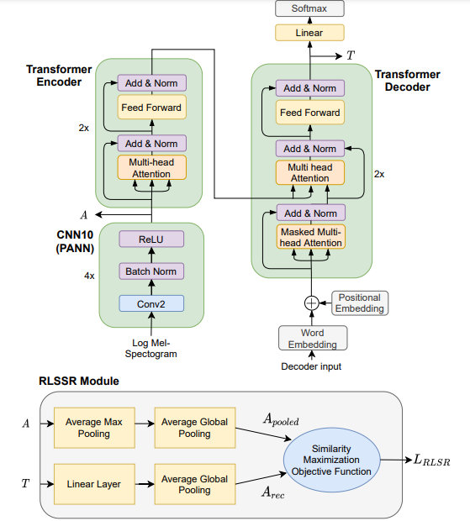
C1.2a Model architecture
Encoder
Transformer Encoder and CNN10 Encoder
Decoder
Transformer Decoder
Supplementary Objective
Reconstruction Latent Space Similarity Regularization (RLSSR) Module
Notes:
This is the full model architecture
Describe
Encoder
Decoder
Click - Highlight the T and A
RLSSR (I will go into more details next slide)

Slide 23
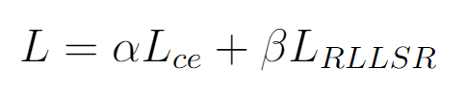
C1.2b Model architecture
Reconstruction Latent Space Similarity Regularization (RLSSR) Module
Choice of distance loss: L1, L2
Published as:
A. Koh, X. Fuzhao and C. E. Siong, ”Automated Audio Captioning Using Transfer Learning and Reconstruction Latent Space Similarity Regularization,” ICASSP 2022 - 2022 IEEE International Conference on Acoustics, Speech and Signal Processing (ICASSP), 2022, pp. 7722-7726, doi: 10.1109/ICASSP43922.2022.9747676.
Notes:
As mentioned, the module takes in audio and text embedding, and tries to maximize the similarity
The audio embedding is passed through..
The text embedding is passed through..
The similarity maximization objective function used is the L1 and L2 loss, so we tried to minimize the loss
Other loss functions such as cosine similarity or huber loss were used as well, but we found that L1 and L2 worked the best.
This loss is added to the main cross entropy loss with equal weightage

Slide 24
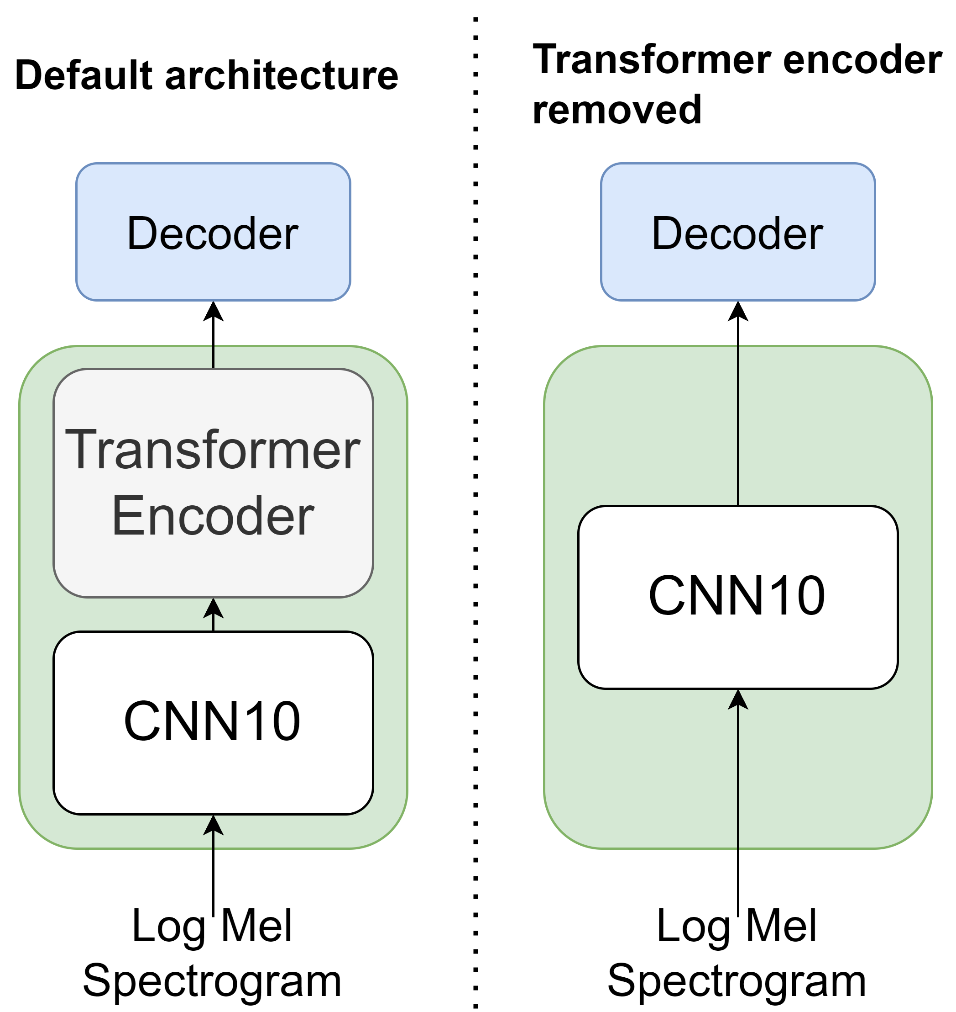
C1.3e1 Experiments
How useful is the transformer audio encoder?
Published as:
A. Koh, X. Fuzhao and C. E. Siong, ”Automated Audio Captioning Using Transfer Learning and Reconstruction Latent Space Similarity Regularization,” ICASSP 2022 - 2022 IEEE International Conference on Acoustics, Speech and Signal Processing (ICASSP), 2022, pp. 7722-7726, doi: 10.1109/ICASSP43922.2022.9747676.

Slide 25
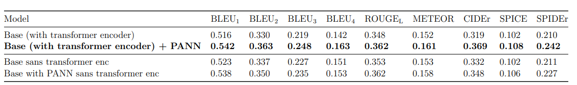
C1.3e1 Experiments
Usefulness of the transformer encoder
Determine addition outperforms or complements the CNN encoder
Transformer encoder + pretrained CNN performed best
Removing transformer encoder expectedly reduced performance
Without pretrained weights (CNN trained from scratch)
Both models performed similarly
Published as:
A. Koh, X. Fuzhao and C. E. Siong, ”Automated Audio Captioning Using Transfer Learning and Reconstruction Latent Space Similarity Regularization,” ICASSP 2022 - 2022 IEEE International Conference on Acoustics, Speech and Signal Processing (ICASSP), 2022, pp. 7722-7726, doi: 10.1109/ICASSP43922.2022.9747676.
Notes:
First tried using pretrained PANNs with transformer encoder, and compared it to a model without pretrained PANNs.
Found that without transformer encoder, it expectedly performed worse when it was unable to model acoustic information from the pretrained embedding

Slide 26
C1.3e1 Experiments
Usefulness of the transformer encoder
Determine addition outperforms or complements the CNN encoder
2. Without pretrained weights (CNN trained from scratch)
Both models performed similarly
3. Combination of PANN and transformer encoder works
Published as:
A. Koh, X. Fuzhao and C. E. Siong, ”Automated Audio Captioning Using Transfer Learning and Reconstruction Latent Space Similarity Regularization,” ICASSP 2022 - 2022 IEEE International Conference on Acoustics, Speech and Signal Processing (ICASSP), 2022, pp. 7722-7726, doi: 10.1109/ICASSP43922.2022.9747676.
Notes:
We then tested a model that did not used pretrained weights. This means that the CNN10 is trained from scratch. Without pretrained embeddings, both models performed similarly. This brings us to believe that the combination of pretrained embeddings and ability of the transformer encoder to learn contextualized information from the pretrained PANN embeddings is important for the model to perform better.

Slide 27
C1.3e1 Experiments
How useful is the transformer audio encoder?
Published as:
A. Koh, X. Fuzhao and C. E. Siong, ”Automated Audio Captioning Using Transfer Learning and Reconstruction Latent Space Similarity Regularization,” ICASSP 2022 - 2022 IEEE International Conference on Acoustics, Speech and Signal Processing (ICASSP), 2022, pp. 7722-7726, doi: 10.1109/ICASSP43922.2022.9747676.
Notes:
This table is the summary of the results we just shown.
Overall, we found that using the transformer encoder with pretrained PANNs yielded the best results. The transformer audio encoder is useful in conjunction with a pretrained PANN in order to leverage the learned acoustic information.

Slide 28
C1.3e2 Experiments
How useful is the Reconstruction Latent Space Similarity Regularization (RLSSR) module?
Published as:
A. Koh, X. Fuzhao and C. E. Siong, ”Automated Audio Captioning Using Transfer Learning and Reconstruction Latent Space Similarity Regularization,” ICASSP 2022 - 2022 IEEE International Conference on Acoustics, Speech and Signal Processing (ICASSP), 2022, pp. 7722-7726, doi: 10.1109/ICASSP43922.2022.9747676.

Slide 29
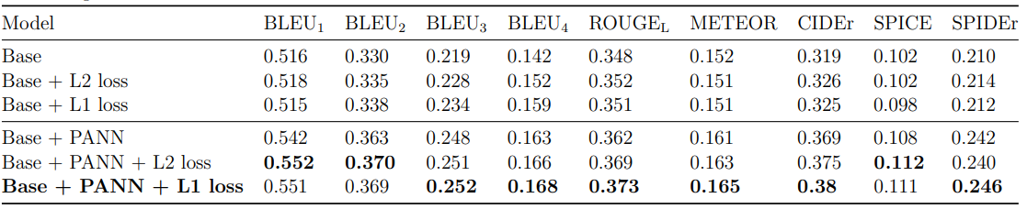
C1.3e2 Experiments
Effect of the Reconstruction Latent Space Similarity Regularization (RLSSR) Module
L1 loss has a slight edge over L2 loss
Using RLSSR yielded a consistent improvement
Published as:
A. Koh, X. Fuzhao and C. E. Siong, ”Automated Audio Captioning Using Transfer Learning and Reconstruction Latent Space Similarity Regularization,” ICASSP 2022 - 2022 IEEE International Conference on Acoustics, Speech and Signal Processing (ICASSP), 2022, pp. 7722-7726, doi: 10.1109/ICASSP43922.2022.9747676.
Notes:
We trained models without pretrained weights (top half of the table), and with pretrained weights (bottom half indicated by PANN). We find that L1 loss generally has a slight edge over the L2 loss

Slide 30
C1.3e2 Experiments
Effect of the Reconstruction Latent Space Similarity Regularization (RLSSR) Module
L1 loss has a slight edge over L2 loss
Using RLSSR yielded a consistent improvement over not using
Published as:
A. Koh, X. Fuzhao and C. E. Siong, ”Automated Audio Captioning Using Transfer Learning and Reconstruction Latent Space Similarity Regularization,” ICASSP 2022 - 2022 IEEE International Conference on Acoustics, Speech and Signal Processing (ICASSP), 2022, pp. 7722-7726, doi: 10.1109/ICASSP43922.2022.9747676.
Notes:
Using RLSSR (red boxes) also yielded a consistent improvement over not using the module ) first row of each half

Slide 31
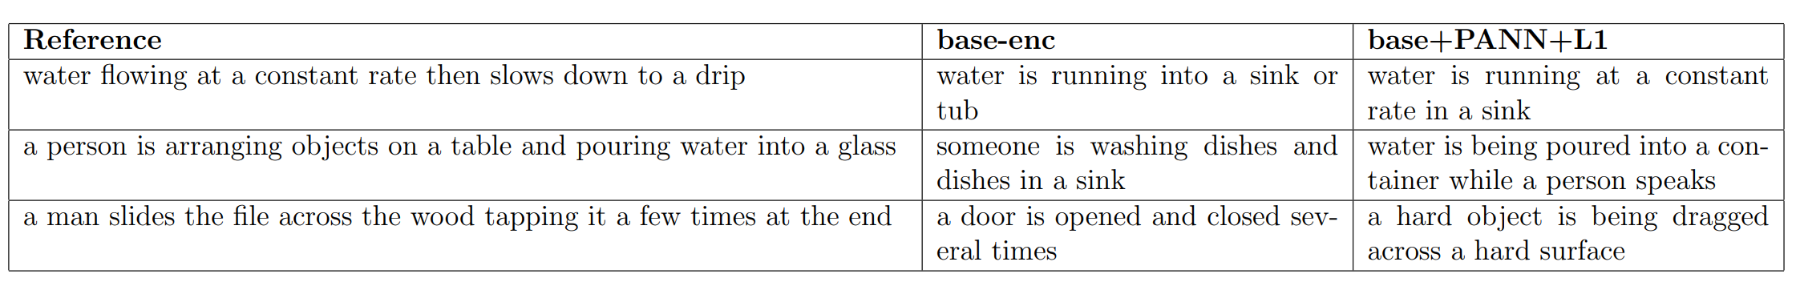
C1.3e4 Experiments
Comparison of generated captions
Published as:
A. Koh, X. Fuzhao and C. E. Siong, ”Automated Audio Captioning Using Transfer Learning and Reconstruction Latent Space Similarity Regularization,” ICASSP 2022 - 2022 IEEE International Conference on Acoustics, Speech and Signal Processing (ICASSP), 2022, pp. 7722-7726, doi: 10.1109/ICASSP43922.2022.9747676.

Slide 32
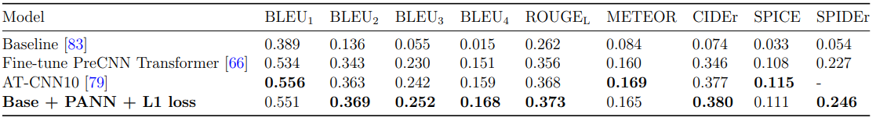
C1.3e3 Experiments
How useful is the Reconstruction Latent Space Similarity Regularization (RLSSR) module?
Outperforms SOTA on most metrics
Previous SOTA
is not end-to-end
uses a pipeline which can lead to error propagation
RLSSR is
simple to implement
easy to train
Published as:
A. Koh, X. Fuzhao and C. E. Siong, ”Automated Audio Captioning Using Transfer Learning and Reconstruction Latent Space Similarity Regularization,” ICASSP 2022 - 2022 IEEE International Conference on Acoustics, Speech and Signal Processing (ICASSP), 2022, pp. 7722-7726, doi: 10.1109/ICASSP43922.2022.9747676.

Slide 33
Outline
1. Automated Audio Captioning (AAC)
What is AAC?
How are AAC models trained?
Which datasets, encoders, and decoders are used for AAC?
How are AAC models evaluated?
C1: Reconstruction Latent Space Similarity Regularization for AAC
C2: Epochal Difficult Captions for AAC
2. Language Based Audio Retrieval (LBAR)
What is LBAR?
How are LBAR models trained?
What datasets are used for LBAR?
How are LBAR models evaluated?
C3: Converging Tied Layers for LBAR
Conclusions & Future Work

Slide 34
C2: Epochal Difficult Captions for Automated Audio Captioning
C2.1 Motivation
C2.2 Proposed Approach
C2.3 Experiments and results
Published as:
A. Koh, S. Tiwari and C. E. Siong, ”Automated Audio Captioning with Epochal Difficult Captions for curriculum learning,” 2022 Asia-Pacific Signal and Information Processing Association Annual Summit and Conference (APSIPA ASC), 2022, pp. 1058-1063, doi: 10.23919/APSIPAASC55919.2022.9980242.

Slide 35
C2.1 Motivation
Keyword Estimation commonly used
Supplementary task
Keywords are up to authors' interpretation and choice of rules
Heavy preprocessing required
Published as:
A. Koh, S. Tiwari and C. E. Siong, ”Automated Audio Captioning with Epochal Difficult Captions for curriculum learning,” 2022 Asia-Pacific Signal and Information Processing Association Annual Summit and Conference (APSIPA ASC), 2022, pp. 1058-1063, doi: 10.23919/APSIPAASC55919.2022.9980242.
Notes:
As mentioned earlier,

Slide 36
C2.1 Motivation
Keyword Estimation commonly used
Supplementary task
Keywords are up to authors' interpretation and choice of rules
Heavy preprocessing required
Curriculum learning
Allows us to reframe the keyword estimation problem
No additional loss function
data manipulation
Published as:
A. Koh, S. Tiwari and C. E. Siong, ”Automated Audio Captioning with Epochal Difficult Captions for curriculum learning,” 2022 Asia-Pacific Signal and Information Processing Association Annual Summit and Conference (APSIPA ASC), 2022, pp. 1058-1063, doi: 10.23919/APSIPAASC55919.2022.9980242.

Slide 37
C2.1b Curriculum Learning
Easy
Hard
Training
Water flowing constant
Water flowing at a constant rate
Published as:
A. Koh, S. Tiwari and C. E. Siong, ”Automated Audio Captioning with Epochal Difficult Captions for curriculum learning,” 2022 Asia-Pacific Signal and Information Processing Association Annual Summit and Conference (APSIPA ASC), 2022, pp. 1058-1063, doi: 10.23919/APSIPAASC55919.2022.9980242.
Notes:
A short example now, and I will go into more details in the next few slides

Slide 38
C2.2 Proposed Approach
Epochal Difficult Captions
Difficulty level as a function of epoch
Stopwords curriculum
Frequency curriculum
Published as:
A. Koh, S. Tiwari and C. E. Siong, ”Automated Audio Captioning with Epochal Difficult Captions for curriculum learning,” 2022 Asia-Pacific Signal and Information Processing Association Annual Summit and Conference (APSIPA ASC), 2022, pp. 1058-1063, doi: 10.23919/APSIPAASC55919.2022.9980242.

Slide 39
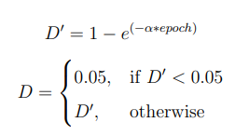
C2.2a Difficulty level as a function of epoch
Allows us to manipulate the data accordingly
where α is a hyperparameter which controls the rate of difficulty increase
Published as:
A. Koh, S. Tiwari and C. E. Siong, ”Automated Audio Captioning with Epochal Difficult Captions for curriculum learning,” 2022 Asia-Pacific Signal and Information Processing Association Annual Summit and Conference (APSIPA ASC), 2022, pp. 1058-1063, doi: 10.23919/APSIPAASC55919.2022.9980242.
Notes:
First, we have to determine the difficulty level. We do that by creating a function using the exponential of the epoch number. We also enforce a 0.05 floor for the difficulty level

Slide 40
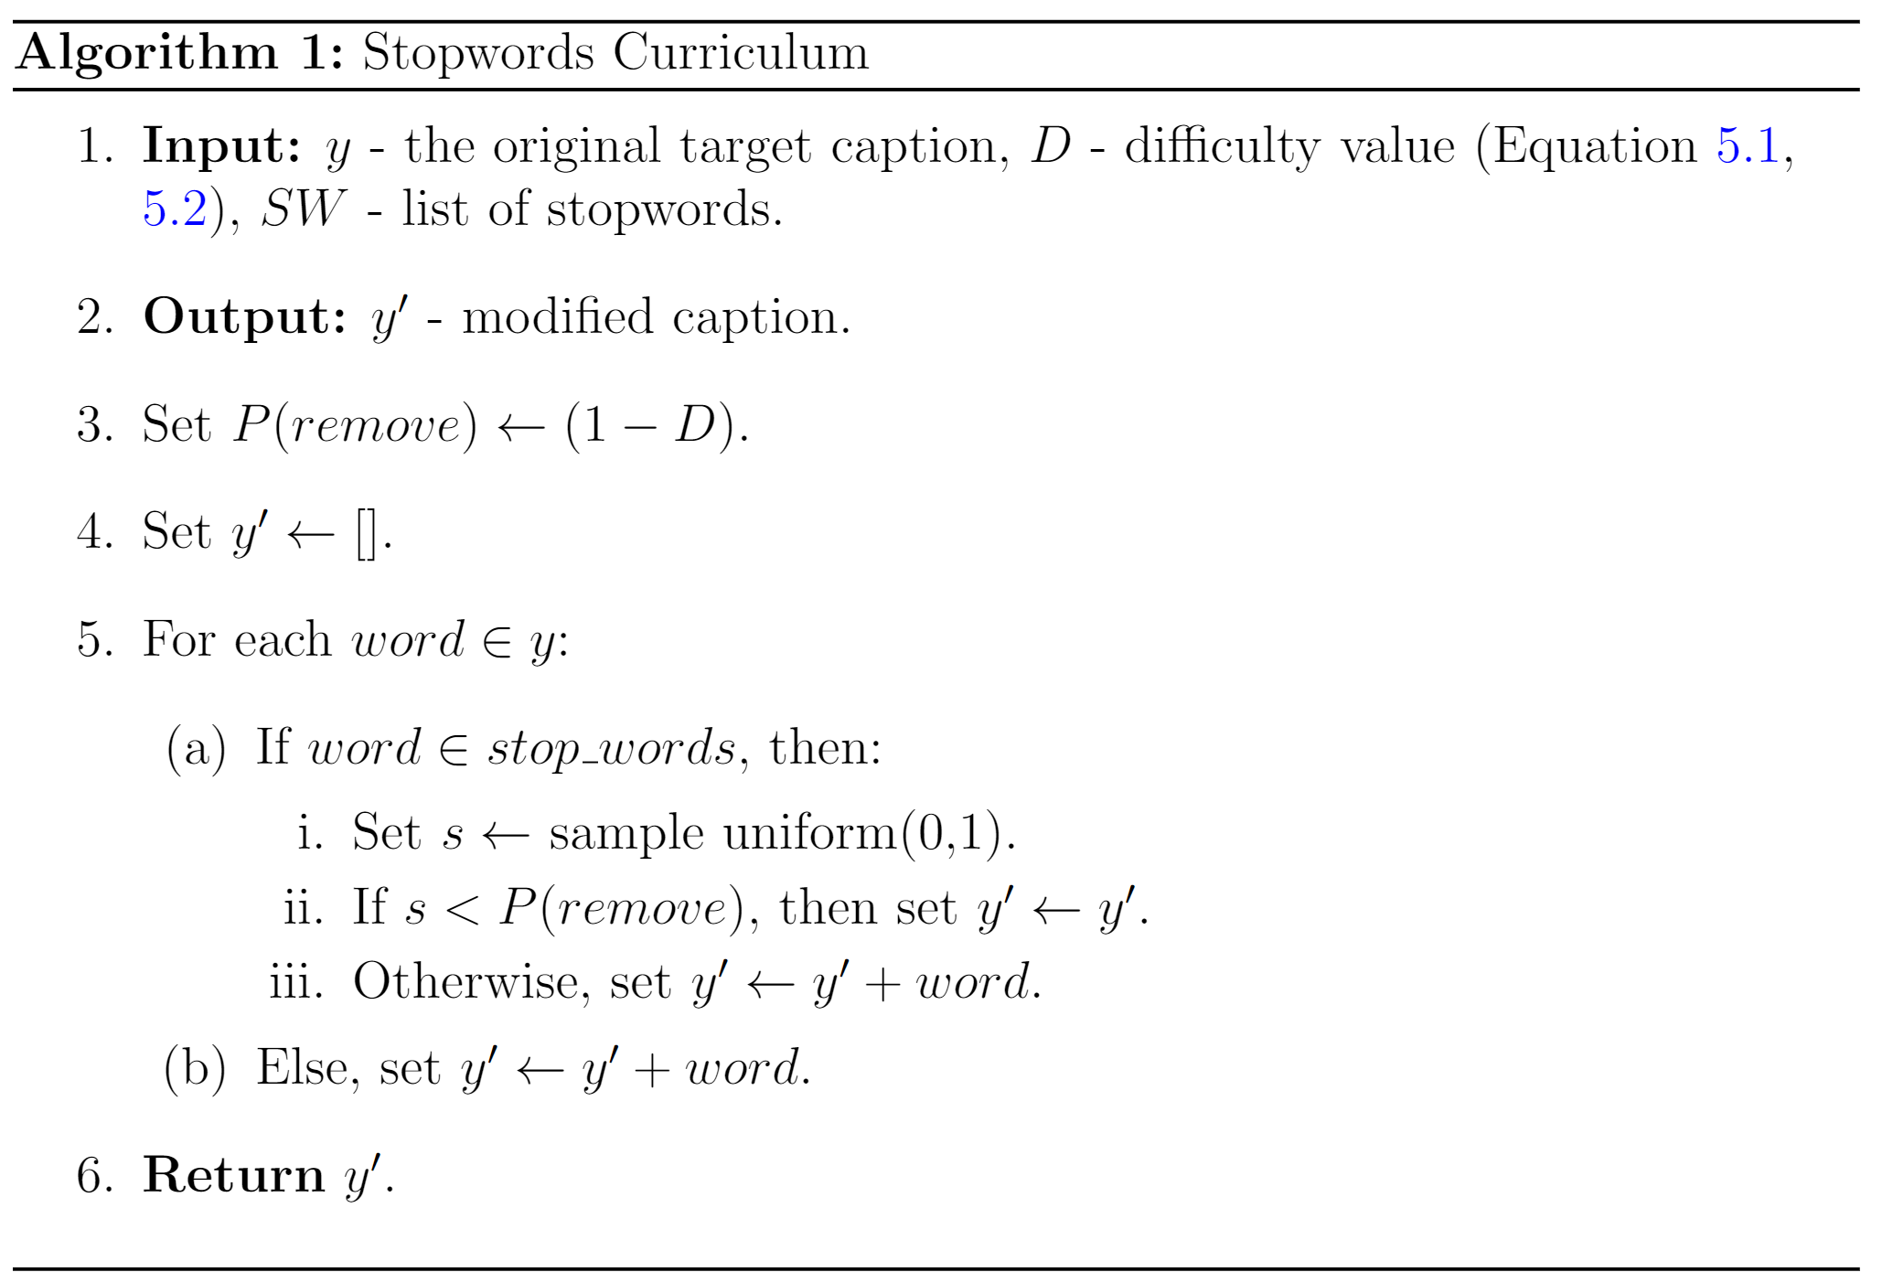
C2.2b Stopwords curriculum
Probability of removing stopwords^{[a]} based on the difficulty
Low Difficulty -> more stopwords removed
High Difficulty -> less stopwords removed
Defaults to almost original caption at high difficulty
[a] https://www.nltk.org/
Published as:
A. Koh, S. Tiwari and C. E. Siong, ”Automated Audio Captioning with Epochal Difficult Captions for curriculum learning,” 2022 Asia-Pacific Signal and Information Processing Association Annual Summit and Conference (APSIPA ASC), 2022, pp. 1058-1063, doi: 10.23919/APSIPAASC55919.2022.9980242.
Notes:
Using a publicly available list of stopwords from NLTK, we can manipulate the training captions.
Basically, there is a probablity of dropping every stopword depending on the difficulty level.
At low difficulty, we want to use almost all keywords, so more stopwords are removed
At high difficulty, we want to use close to the original caption, so less stopwords are removed.

Slide 41
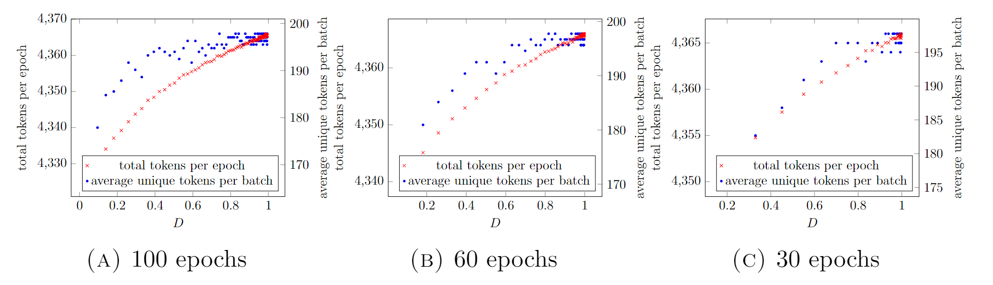
C2.2b Average Unique Tokens vs Difficulty Level
Published as:
A. Koh, S. Tiwari and C. E. Siong, ”Automated Audio Captioning with Epochal Difficult Captions for curriculum learning,” 2022 Asia-Pacific Signal and Information Processing Association Annual Summit and Conference (APSIPA ASC), 2022, pp. 1058-1063, doi: 10.23919/APSIPAASC55919.2022.9980242.
Notes:
Plot of total tokens per epoch on the left y axis, and average unique tokens per batch on the right y axis. The difficulty level is on the x axis
The blue dot is the average unique tokens per batch. It starts out at around 170 at low difficulty, and reaches the peak of around 195 at around 0.8 difficulty. The total tokens per epoch follows a similar trend

Slide 42
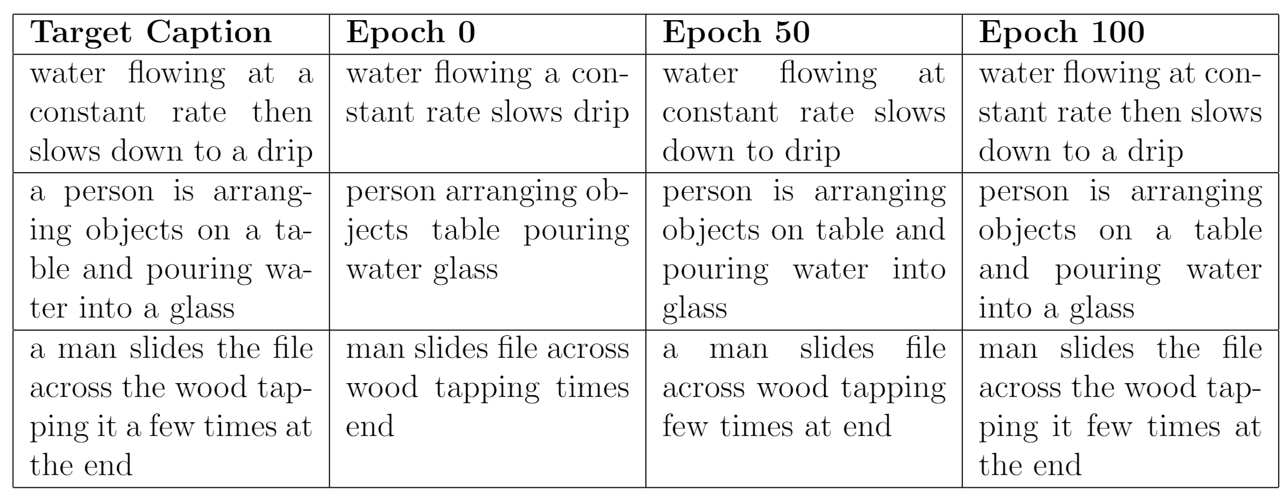





































C2.2b Stopwords curriculum
Published as:
A. Koh, S. Tiwari and C. E. Siong, ”Automated Audio Captioning with Epochal Difficult Captions for curriculum learning,” 2022 Asia-Pacific Signal and Information Processing Association Annual Summit and Conference (APSIPA ASC), 2022, pp. 1058-1063, doi: 10.23919/APSIPAASC55919.2022.9980242.

Slide 43
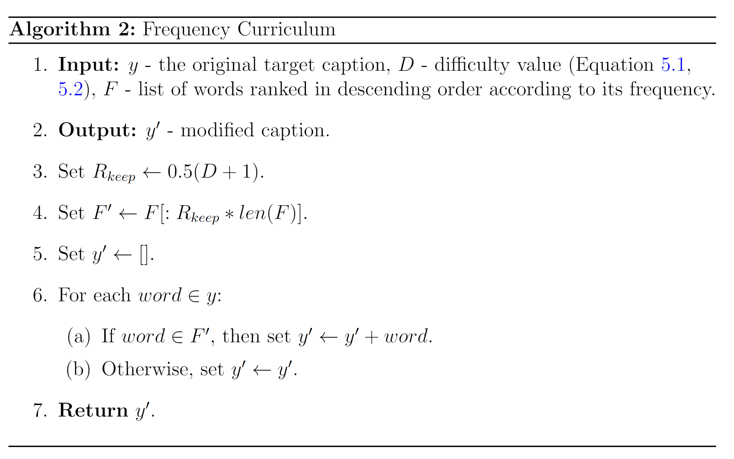
C2.2c Frequency curriculum
Removes infrequent words based on the difficulty
Defaults to almost original caption at high difficulty
Frequent
Training
Infrequent words added
Water at a rate then slows down to a
Water flowing at a constant rate then slows down to a drip
Published as:
A. Koh, S. Tiwari and C. E. Siong, ”Automated Audio Captioning with Epochal Difficult Captions for curriculum learning,” 2022 Asia-Pacific Signal and Information Processing Association Annual Summit and Conference (APSIPA ASC), 2022, pp. 1058-1063, doi: 10.23919/APSIPAASC55919.2022.9980242.
Notes:
Stopwords are often common words which will be high in frequency
The frequency curriculum is also proposed to contrast the stopwords curriculum.
At low difficulty, we will remove infrequent words.
How common the words are determined by the number of those words in the dataset. We calculate the frequency of each word then remove the words if they are infrequent enough.

Slide 44
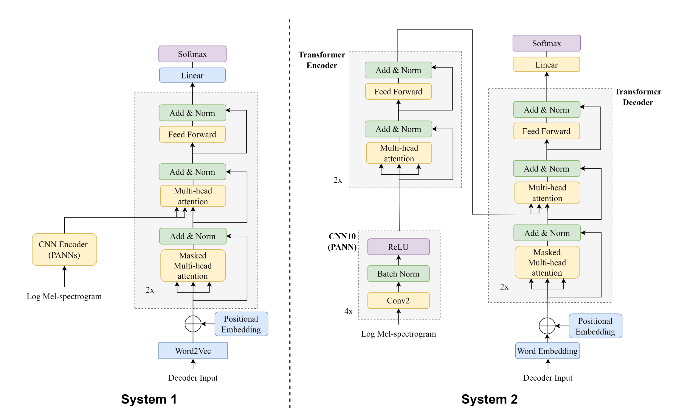
C2.3 Model architecture
System 1: Xinhao Mei, Qiushi Huang, Xubo Liu, Gengyun Chen, Jingqian Wu, Yusong Wu, Jinzheng ZHAO, Shengchen Li, Tom Ko, H. Tang, Xi Shao, Mark D. Plumbley, and Wenwu Wang. An Encoder-Decoder Based Audio Captioning System with Transfer and Reinforcement Learning. In Proceedings of the 6th Detection and Classification of Acoustic Scenes and Events 2021 Workshop (DCASE2021), pages 206–210, Barcelona, Spain, November 2021. ISBN 978- 84-09-36072-7.
System 2: Andrew Koh, Xue Fuzhao, and Chng Eng Siong. Automated audio captioning using transfer learning and reconstruction latent space similarity regularization. In ICASSP 2022 - 2022 IEEE International Conference on Acoustics, Speech and Signal Processing (ICASSP), pages 7722–7726, 2022. doi: 10.1109/ICASSP43922.2022.9747676.
Notes:
We tested both the stopwords and freq curr on two different systems
Both systems are models from previous work.
System 1 … (describe the model)
System 2 … (describe the model)
Important to note that we are checking for the effectiveness of curriculum learning, so the choice of system is not as important.
Rather, it is more important that the use of epochal difficult captions helps the model to improve.

Slide 45
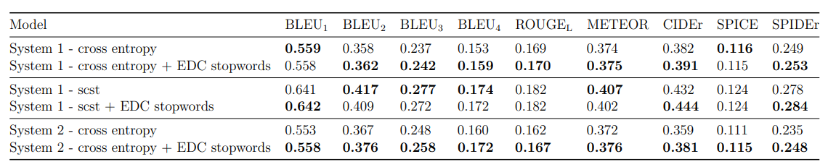
C2.4e1 Experiments
How effective is the stopwords curriculum?
Improvement of up to 5.5% in SPIDEr, as well as consistent improvement in METEOR and CIDEr scores.
Published as:
A. Koh, S. Tiwari and C. E. Siong, ”Automated Audio Captioning with Epochal Difficult Captions for curriculum learning,” 2022 Asia-Pacific Signal and Information Processing Association Annual Summit and Conference (APSIPA ASC), 2022, pp. 1058-1063, doi: 10.23919/APSIPAASC55919.2022.9980242.
Notes:
System 1 was trained on two settings, using cross entropy and Self-critical Sequence Training, which is a form of reinforcement learning.
System 2 was only trained on cross entropy.
Across all 3 settings, we find an improvement of up to 5.5% in SPIDEr, as well as consistent improvement in METEOR and CIDEr scores

Slide 46
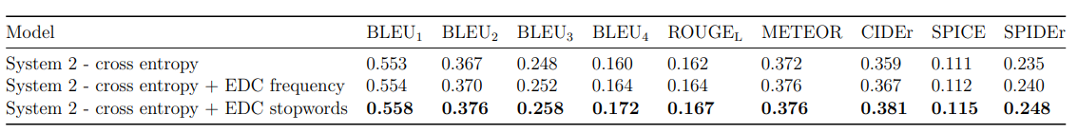
C2.4e1 Experiments
How effective is the frequency curriculum?
Effective for model training
Not as effective as stopwords curriculum
Published as:
A. Koh, S. Tiwari and C. E. Siong, ”Automated Audio Captioning with Epochal Difficult Captions for curriculum learning,” 2022 Asia-Pacific Signal and Information Processing Association Annual Summit and Conference (APSIPA ASC), 2022, pp. 1058-1063, doi: 10.23919/APSIPAASC55919.2022.9980242.
Notes:
As for the frequency curriculum, the increase in SPIDEr score is only 2% and hence is not as effective as the stopwords curriculum which has a 5.5% SPIDEr score increase.
we can infer that the stopwords curriculum is a more accurate approximation of the keyword estimation problem when compared to the frequency curriculum. While the frequency curriculum is a useful method for aiding model training, it is not as effective as the stopwords curriculum, We also note that the use of curriculum learning seems to lend some slight performance improvement regardless of the choice of curriculum.

Slide 47
Outline
1. Automated Audio Captioning (AAC)
What is AAC?
How are AAC models trained?
Which datasets, encoders, and decoders are used for AAC?
How are AAC models evaluated?
C1: Reconstruction Latent Space Similarity Regularization for AAC
C2: Epochal Difficult Captions for AAC
2. Language Based Audio Retrieval (LBAR)
What is LBAR?
How are LBAR models trained?
What datasets are used for LBAR?
How are LBAR models evaluated?
C3: Converging Tied Layers for LBAR
Conclusions & Future Work
Notes:
Now we will move on to the LBAR part of my research.

Slide 48
Recap: AAC and LBAR
Automated Audio Captioning ^{[11]}
Describe audio events using natural language
Language based Audio Retrieval ^{[3]}
Retrieve the most relevant audio clip
Retrieve the most relevant audio clip
(done by ranking a collection of audio clips)
[11] Konstantinos Drossos, Sharath Adavanne, and Tuomas Virtanen. Automated audio captioning with recurrent neural networks. In 2017 IEEE Workshop on Applications of Signal Processing to Audio and Acoustics (WASPAA), pages 374–378, 2017. doi:10.1109/WASPAA.2017.8170058.​
[3] Xuenan Xu, Heinrich Dinkel, Mengyue Wu, and Kai Yu. Text-to-Audio Grounding: Building Correspondence Between Captions and Sound Events. In ICASSP 2021 - 2021 IEEE International Conference on Acoustics, Speech and Signal Processing (ICASSP), pages 606–610, 2021. doi: 10.1109/ ICASSP39728.2021.9414834.
Notes:
Just a quick recap, LBAR is sort of the inverse of AAC. While AAC takes in audio and generates a caption, LBAR takes in a query caption and retrieves the most relevant audio clip

Slide 49
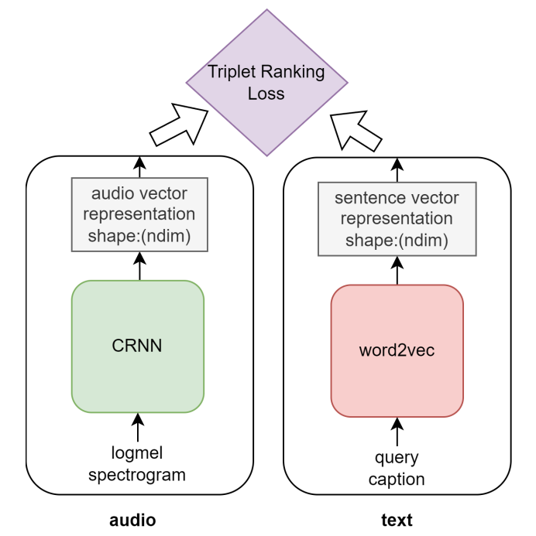
2a) How does LBAR differ from AAC
LBAR ^{[3]} is not a generative task
Training: Triplet Ranking loss
[3] Xuenan Xu, Heinrich Dinkel, Mengyue Wu, and Kai Yu. Text-to-Audio Grounding: Building Correspondence Between Captions and Sound Events. In ICASSP 2021 - 2021 IEEE International Conference on Acoustics, Speech and Signal Processing (ICASSP), pages 606–610, 2021. doi: 10.1109/ ICASSP39728.2021.9414834.
Notes:
LBAR is not a generative task. Therefore, decoders are not needed. Training is done using a triplet ranking loss. I will go into more details later.

Slide 50
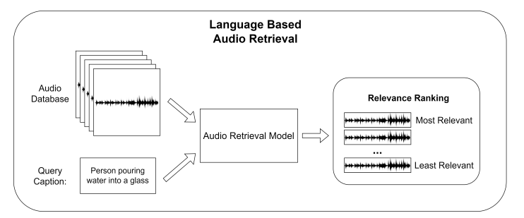
2a) How does LBAR differ from AAC
LBAR ^{[3]} is not a generative task
Training: Triplet Ranking loss
Evaluation: similarity metric
[3] Xuenan Xu, Heinrich Dinkel, Mengyue Wu, and Kai Yu. Text-to-Audio Grounding: Building Correspondence Between Captions and Sound Events. In ICASSP 2021 - 2021 IEEE International Conference on Acoustics, Speech and Signal Processing (ICASSP), pages 606–610, 2021. doi: 10.1109/ ICASSP39728.2021.9414834.
Notes:
As for evaluation, the model encodes all the audio clips as well as the query caption. The dot product between each audio clip and the query caption is computed, and the pair with the highest dot product is the most relevant.

Slide 51
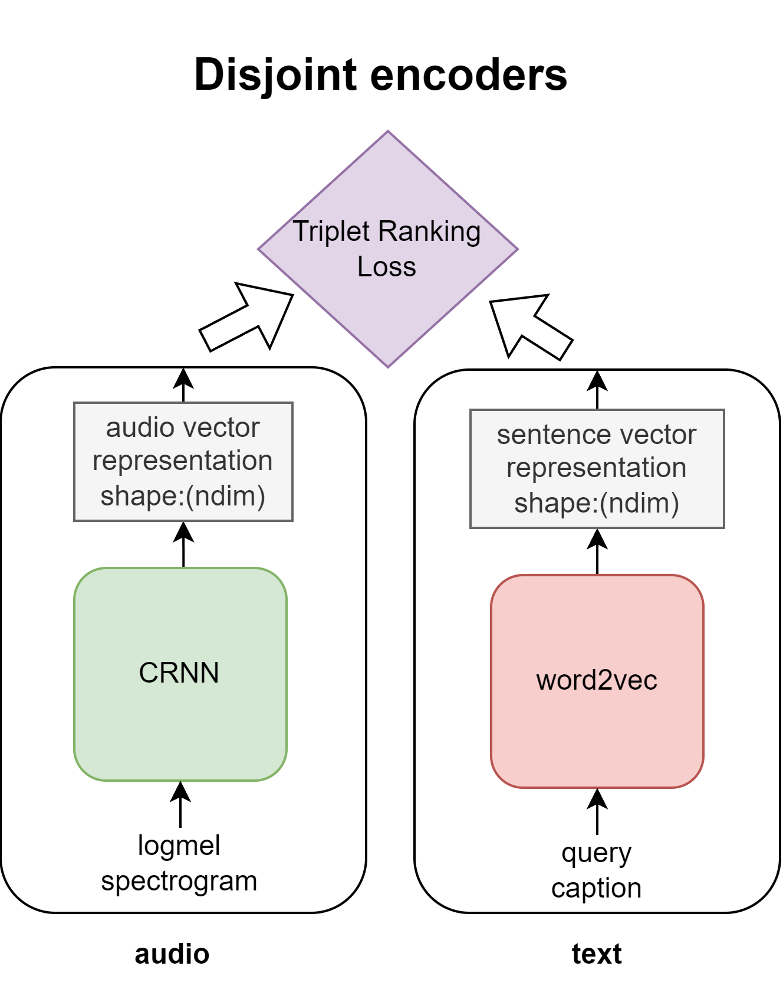
2b) How are LBAR models trained?
Dual Encoder architecture
Triplet Ranking Loss to optimize the model
Pretrained encoders are often used
Similar choices as those in AAC
[3] Xuenan Xu, Heinrich Dinkel, Mengyue Wu, and Kai Yu. Text-to-Audio Grounding: Building Correspondence Between Captions and Sound Events. In ICASSP 2021 - 2021 IEEE International Conference on Acoustics, Speech and Signal Processing (ICASSP), pages 606–610, 2021. doi: 10.1109/ ICASSP39728.2021.9414834.​
Notes:
-dual encoder
In this example the audio CRNN encoder encodes the logmel spectrogram and the word2vec produces text embeddings for the query caption.
Using the triplet ranking loss,The model is trained to maximize the dot product between positive pairs
It is also common for pretrained encoders, like those in AAC, to be used.

Slide 52
2b) What information should LBAR models have?
Robust natural language understanding
Ability to match textual information to acoustic information
Notes:
In order for good retrieval performance, the model requires good natural language understanding and the ability to match the textual information to acoustic information. As relevance is determined by the dot product, it is also important that the text and audio embeddings of the same content are close in distance in the embedding space.

Slide 53
2c) Which datasets are used for audio retrieval?
Datasets with audio-caption pairing
Most work focus on the Clotho Dataset
Some work on Audio Grounding Dataset (subset of Audioset)
Dataset | Number of Samples | Audio length (s)
Clotho Dataset | 4981 | 15-30
Audio Grounding | 4590 | <10

Slide 54
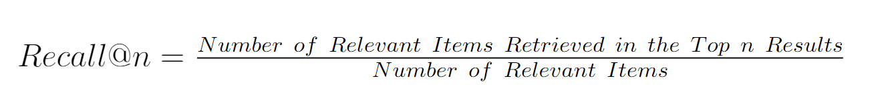
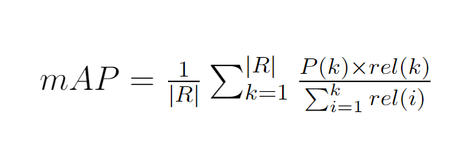
2d) How is evaluation of LBAR models done?
Recall@1, 5,10
mean Average Precision (mAP) @10
Notes:
Recall=Number of True Positives divided by the sum of False Negatives and True Positives
MAP@10 is simply the Average precision among the top-10 retrieved results, averaged across all caption queries.

Slide 55
Outline
1. Automated Audio Captioning (AAC)
What is AAC?
How are AAC models trained?
Which datasets, encoders, and decoders are used for AAC?
How are AAC models evaluated?
C1: Reconstruction Latent Space Similarity Regularization for AAC
C2: Epochal Difficult Captions for AAC
2. Language Based Audio Retrieval (LBAR)
What is LBAR?
How are LBAR models trained?
What datasets are used for LBAR?
How are LBAR models evaluated?
C3: Converging Tied Layers for LBAR
Conclusions & Future Work

Slide 56
C3: Converging Tied Layers for Language based Audio Retrieval
C3.1 Motivation
C3.2 Proposed Approach and Architecture
C3.3 Experiments and results
Published as:
A. Koh and C. E. Siong, ”Language-based audio retrieval with Converging Tied Layers and Contrastive Loss,” 2022 Asia-Pacific Signal and Information Processing Association Annual Summit and Conference (APSIPA ASC), 2022, pp. 1644-1648, doi: 10.23919/APSIPAASC55919.2022.9979840.

Slide 57
C3.1 Motivation
Disjoint Encoders
Makes it non trivial for optimizing a ranking task
Different modalities uses their own encoder
Published as:
A. Koh and C. E. Siong, ”Language-based audio retrieval with Converging Tied Layers and Contrastive Loss,” 2022 Asia-Pacific Signal and Information Processing Association Annual Summit and Conference (APSIPA ASC), 2022, pp. 1644-1648, doi: 10.23919/APSIPAASC55919.2022.9979840.
Notes:
As mentioned earlier, disjoint encoders are often used to produce audio and text embeddings

Slide 58
C3.1 Motivation
Disjoint Encoders
Shared parameters
Recurring theme in Natural Language Processing
Makes it non trivial for optimizing a ranking task
Different modalities uses their own encoder
Helps to align subspaces for different modalities
Published as:
A. Koh and C. E. Siong, ”Language-based audio retrieval with Converging Tied Layers and Contrastive Loss,” 2022 Asia-Pacific Signal and Information Processing Association Annual Summit and Conference (APSIPA ASC), 2022, pp. 1644-1648, doi: 10.23919/APSIPAASC55919.2022.9979840.

Slide 59
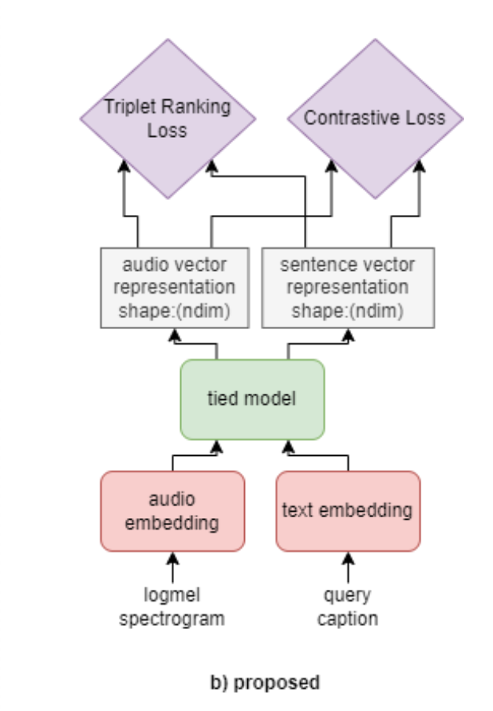
C3.2 Proposed Approach
Pretrained Embeddings
Converging Tied Layers
Contrastive Loss
Notes:
Proposed approach consists of 3 parts.

Slide 60
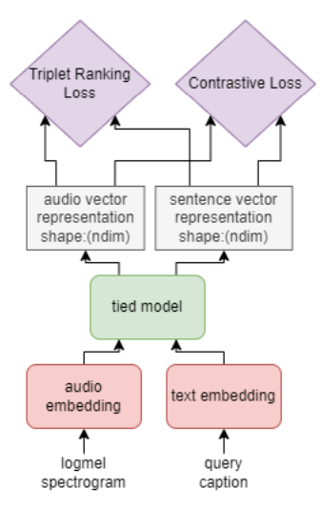
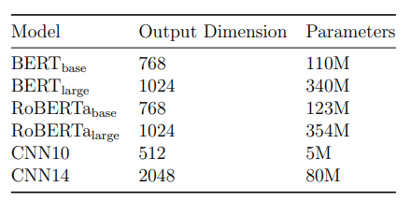
C3.2a Proposed Approach
Pretrained Embeddings
Sufficient to use embeddings as it is
Otherwise stated, these pretrained embeddings are frozen and not finetuned
Published as:
A. Koh and C. E. Siong, ”Language-based audio retrieval with Converging Tied Layers and Contrastive Loss,” 2022 Asia-Pacific Signal and Information Processing Association Annual Summit and Conference (APSIPA ASC), 2022, pp. 1644-1648, doi: 10.23919/APSIPAASC55919.2022.9979840.

Slide 61
C3.2b Proposed Approach
b. Converging Tied Layers
Take in audio and text embeddings
Project these embeddings to a common subspace
Choice of tied layers
Transformer encoder layers
Linear layers
Published as:
A. Koh and C. E. Siong, ”Language-based audio retrieval with Converging Tied Layers and Contrastive Loss,” 2022 Asia-Pacific Signal and Information Processing Association Annual Summit and Conference (APSIPA ASC), 2022, pp. 1644-1648, doi: 10.23919/APSIPAASC55919.2022.9979840.

Slide 62
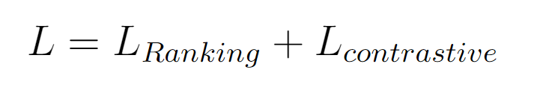
C3.2c Proposed Approach
c. Contrastive Loss
Supplementary Contrastive loss
Same Contrastive loss as that from CLIP ^{[2]}
Trained jointly with ranking loss
Published as:
A. Koh and C. E. Siong, ”Language-based audio retrieval with Converging Tied Layers and Contrastive Loss,” 2022 Asia-Pacific Signal and Information Processing Association Annual Summit and Conference (APSIPA ASC), 2022, pp. 1644-1648, doi: 10.23919/APSIPAASC55919.2022.9979840.
[2] Alec Radford, Jong Wook Kim, Chris Hallacy, Aditya Ramesh, Gabriel Goh, Sandhini Agarwal, Girish Sastry, Amanda Askell, Pamela Mishkin, Jack Clark, Gretchen Krueger, and Ilya Sutskever. Learning Transferable Visual Models From Natural Language Supervision. In Marina Meila and Tong Zhang, editors, Proceedings of the 38th International Conference on Machine Learning, volume 139 of Proceedings of Machine Learning Research, pages 8748–8763. PMLR, 18–24 Jul 2021. URL https://proceedings.mlr. press/v139/radford21a.html

Slide 63
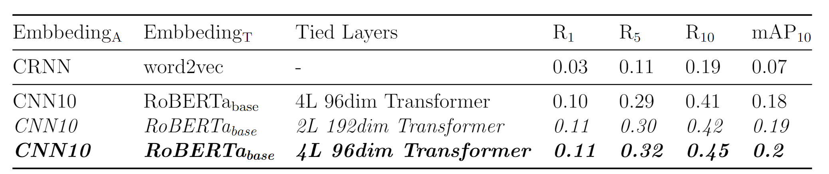
C3.3 Experiments
Summary of all results
Published as:
A. Koh and C. E. Siong, ”Language-based audio retrieval with Converging Tied Layers and Contrastive Loss,” 2022 Asia-Pacific Signal and Information Processing Association Annual Summit and Conference (APSIPA ASC), 2022, pp. 1644-1648, doi: 10.23919/APSIPAASC55919.2022.9979840.
Notes:
Talk about the baseline

Slide 64
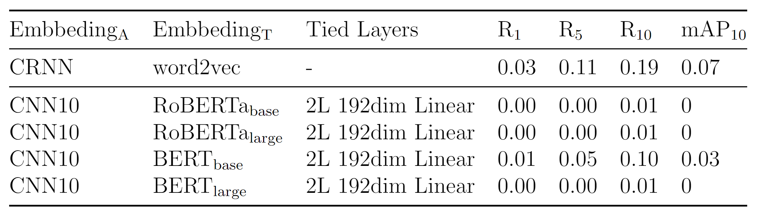
C3.3e1 Experiments
Importance of the Contrastive loss
Models perform very badly without contrastive loss
Indicates that triplet ranking loss alone is insufficient
Published as:
A. Koh and C. E. Siong, ”Language-based audio retrieval with Converging Tied Layers and Contrastive Loss,” 2022 Asia-Pacific Signal and Information Processing Association Annual Summit and Conference (APSIPA ASC), 2022, pp. 1644-1648, doi: 10.23919/APSIPAASC55919.2022.9979840.
Notes:
We find that models perform very badly without contrastive loss
Indicates that triplet ranking loss alone is insufficient ,
hypothesize that when used in conjunction, the contrastive loss and triplet ranking loss complement each other.
The triplet ranking loss enforces a broad notion of similarity, encouraging the network to understand relative relationships within triplets.
The contrastive loss provides a fine-grained measure of similarity between pairs, aiding in separating positive and negative pairs effectively.
This combined approach helps the model to learn a more robust and discriminative feature space, leading to improved retrieval performance.

Slide 65
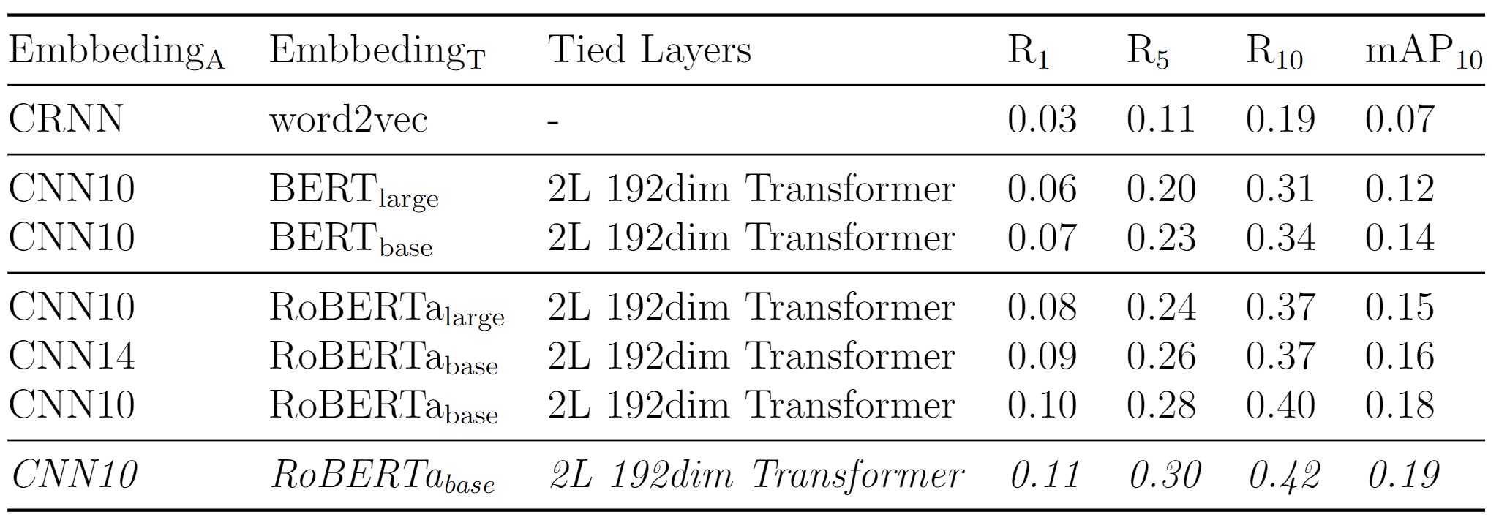
C3.3e2 Experiments
Impact of using trainable or frozen pretrained embeddings
Audio retrieval performance is correlated to the quality of pretrained models
RoBERTa ^{[128]} performs better than BERT ^{[94]}
Published as:
A. Koh and C. E. Siong, ”Language-based audio retrieval with Converging Tied Layers and Contrastive Loss,” 2022 Asia-Pacific Signal and Information Processing Association Annual Summit and Conference (APSIPA ASC), 2022, pp. 1644-1648, doi: 10.23919/APSIPAASC55919.2022.9979840.
[128] Yinhan Liu, Myle Ott, Naman Goyal, Jingfei Du, Mandar Joshi, Danqi Chen, Omer Levy, Mike Lewis, Luke Zettlemoyer, and Veselin Stoyanov. RoBERTa: A Robustly Optimized BERT Pretraining Approach. ArXiv, abs/1907.11692, 2019.
[94] Jacob Devlin, Ming-Wei Chang, Kenton Lee, and Kristina Toutanova. BERT: Pre-training of Deep Bidirectional Transformers for Language Understanding. In Proceedings of the 2019 Conference of the North American Chapter of the Association for Computational Linguistics: Human Language Technologies, Volume 1 (Long and Short Papers), pages 4171–4186, Minneapolis, Minnesota, June 2019. Association for Computational Linguistics. doi: 10.18653/v1/N19-1423.
Notes:
Which is expected, because roBERTa outperforms BERT on several Natural Language Processing benchmarks

Slide 66
C3.3e2 Experiments
Impact of using trainable or frozen pretrained embeddings
Small (base) models tend to perform better than their large counterpart
Published as:
A. Koh and C. E. Siong, ”Language-based audio retrieval with Converging Tied Layers and Contrastive Loss,” 2022 Asia-Pacific Signal and Information Processing Association Annual Summit and Conference (APSIPA ASC), 2022, pp. 1644-1648, doi: 10.23919/APSIPAASC55919.2022.9979840.
Notes:
However, base models tend to perform better than their large counterpart. This could be because of the smaller size of the clotho dataset, and this observation might not apply to bigger datasets.

Slide 67
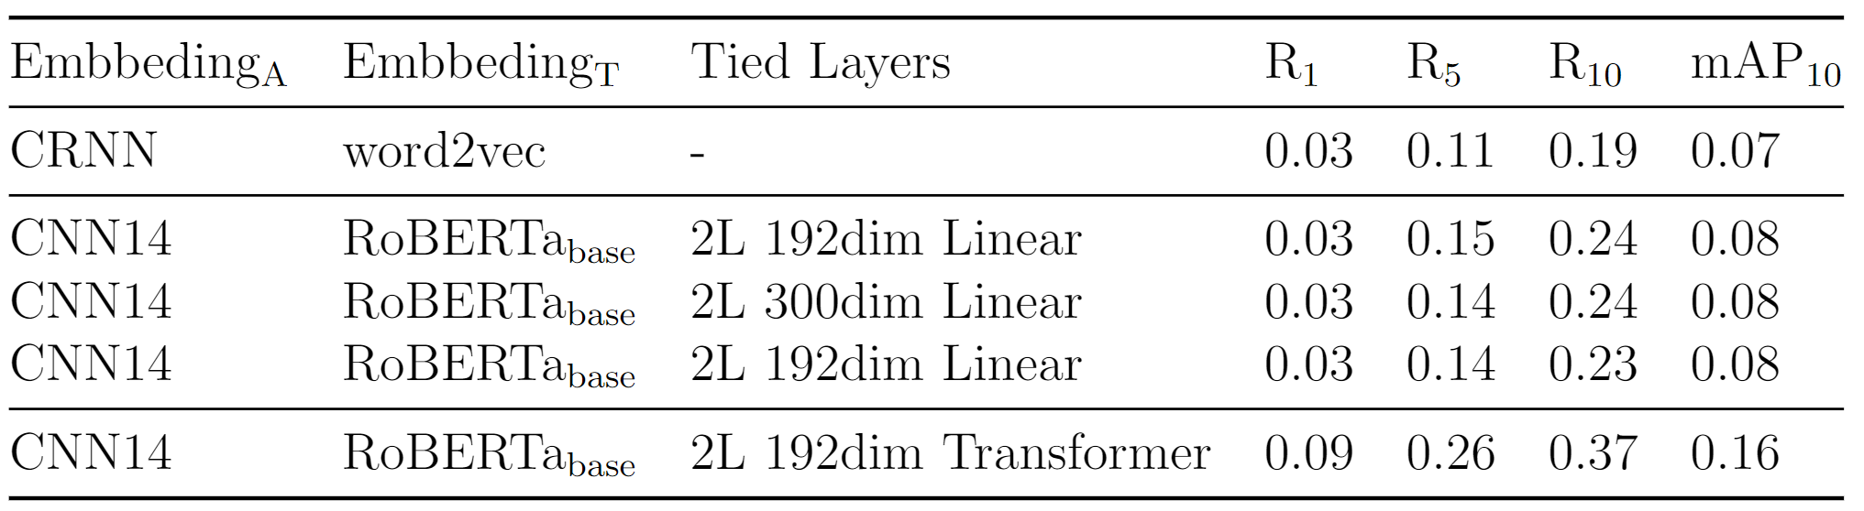
C3.3e3 Experiments
Tied Transformers layers vs Tied Linear layers
Transformers won by a clear margin
Ability to encode contextual information
Published as:
A. Koh and C. E. Siong, ”Language-based audio retrieval with Converging Tied Layers and Contrastive Loss,” 2022 Asia-Pacific Signal and Information Processing Association Annual Summit and Conference (APSIPA ASC), 2022, pp. 1644-1648, doi: 10.23919/APSIPAASC55919.2022.9979840.
Notes:
In our experiments to check the most suitable type of tied layers, transformers layers consistently outperforms converging tied linear linear . This confirms our hypothesis that using
the transformer encoder layers as the choice for Converging Tied layers allows the model to better interpolate contextual information from both the audio embedding
and text embedding to a common subspace.

Slide 68
C3.3 Experiments
Summary of all results
Published as:
A. Koh and C. E. Siong, ”Language-based audio retrieval with Converging Tied Layers and Contrastive Loss,” 2022 Asia-Pacific Signal and Information Processing Association Annual Summit and Conference (APSIPA ASC), 2022, pp. 1644-1648, doi: 10.23919/APSIPAASC55919.2022.9979840.
Notes:
As a summary, (describe best combination)

Slide 69
Outline
1. Automated Audio Captioning (AAC)
What is AAC?
How are AAC models trained?
Which datasets, encoders, and decoders are used for AAC?
How are AAC models evaluated?
C1: Reconstruction Latent Space Similarity Regularization for AAC
C2: Epochal Difficult Captions for AAC
2. Language Based Audio Retrieval (LBAR)
What is LBAR?
How are LBAR models trained?
What datasets are used for LBAR?
How are LBAR models evaluated?
C3: Converging Tied Layers for LBAR
Conclusions & Future Work
Published as:A. Koh and C. E. Siong, ”Language-based audio retrieval with Converging Tied Layers and Contrastive Loss,” 2022 Asia-Pacific Signal and Information Processing Association Annual Summit and Conference (APSIPA ASC), 2022, pp. 1644-1648, doi: 10.23919/APSIPAASC55919.2022.9979840.

Slide 70
4 Conclusions & Future work
Contribution 1 - Reconstruction Latent Space Similarity Regularization (RLSSR):
Self Supervised objective
Easy to implement and train
Improved SOTA on BLEU, SPIDEr metrics.
Contribution 2 – Epochal Difficult Captions:
Can be applied to any system
Elegant evolution of the keyword estimation supplementary task
Improvement of up to 5.5% in SPIDEr
Contribution 3 – Converging Tied Layers:
Significantly beats baseline performance for audio retrieval
Number of trainable parameters relatively small.

Slide 71
4 Conclusions & Future work
Future work 1:
Comprehensive data collection for audio captioning
Clotho's size is relatively small , hence genre variety is limited
Synthetic augmentation from large generative models
Future work 2:
Robust evaluation
Metrics adapted to Automated audio captioning
Future work 3:
Multitask training for both audio captioning and audio retrieval
Fundamentally similar tasks which might complement each other
Future work 4:
Video Captioning

Slide 72
Thank you very much!

